Slide 1

The Field
In Ryu
September 7, 2016

Slide 2
Sets of Numbers / Scalars
N: Natural Numbers
Z: Integer Numbers
Q: Rational Numbers
R: Real Numbers
C: Complex Numbers
Russian doll
Countable or Not

Slide 3
Numbers / Scalar
(In)Finite Subset of Numbers
1,2,3,4,5
All prime numbers
Even numbers less than 100

Slide 4
Operations on a Set
Functions between Sets
Unary: x ➔ z
Binary: (x,y) ➔ z
…
Functional operators: +, -, *, /, …
Closed or Not
The given operation f on any element(s) in the set S returns an element in the same set S.

Slide 5
Group (Abstract Algebra)
A group is a set, G, together with an operation • (called the group law of G) that combines any two elements a and b to form another element, denoted a • b or ab. To qualify as a group, the set and operation, (G, •), must satisfy four requirements known as the group axioms
Closure
For all a, b in G, the result of the operation, a • b, is also in G.
Associativity
For all a, b and c in G, (a • b) • c = a • (b • c).
Identity element
There exists an element e in G, such that for every element a in G, the equation e • a = a • e = a holds. Such an element is unique (see below), and thus one speaks of the identity element.
Inverse element
For each a in G, there exists an element b in G such that a • b = b • a = e, where e is the identity element.

Slide 6
Ring (Abstract Algebra)
A ring is a set R equipped with binary operations + and · satisfying the following three sets of axioms, called the ring axioms
1. R is an abelian group under addition, meaning that
(a + b) + c = a + (b + c) for all a, b, c in R (+ is associative).
a + b = b + a for all a, b in R (+ is commutative).
There is an element 0 in R such that a + 0 = a for all a in R (0 is the additive identity).
For each a in R there exists −a in R such that a + (−a) = 0 (−a is the additive inverse of a).
2. R is a monoid under multiplication, meaning that:
(a ⋅ b) ⋅ c = a ⋅ (b ⋅ c) for all a, b, c in R (⋅ is associative).
There is an element 1 in R such that a ⋅ 1 = a and 1 ⋅ a = a for all a in R (1 is the multiplicative identity).
3. Multiplication is distributive with respect to addition:
a ⋅ (b + c) = (a ⋅ b) + (a ⋅ c) for all a, b, c in R (left distributivity).
(b + c) ⋅ a = (b ⋅ a) + (c ⋅ a) for all a, b, c in R (right distributivity).

Slide 7
Field (Abstract Algebra)
A field is a set F that is a commutative group with respect to two compatible operations, addition and multiplication (the latter excluding zero), with "compatible" being formalized by distributivity, and the caveat that the additive and the multiplicative identities are distinct (0 ≠ 1).
The most common way to formalize this is by defining a field as a set together with two operations, usually called addition and multiplication, and denoted by + and ·, respectively, such that the following axioms hold (note that subtraction and division are defined in terms of the inverse operations of addition and multiplication)

Slide 8
Field (Abstract Algebra)
Closure of F under addition and multiplication
For all a, b in F, both a + b and a · b are in F (or more formally, + and · are binary operations on F).
Associativity of addition and multiplication
For all a, b, and c in F, the following equalities hold: a + (b + c) = (a + b) + c and a · (b · c) = (a · b) · c.
Commutativity of addition and multiplication
For all a and b in F, the following equalities hold: a + b = b + a and a · b = b · a.
Existence of additive and multiplicative identity elements
There exists an element of F, called the additive identity element and denoted by 0, such that for all a in F,a + 0 = a. Likewise, there is an element, called the multiplicative identity element and denoted by 1, such that for all a in F, a · 1 = a. To exclude the trivial ring, the additive identity and the multiplicative identity are required to be distinct.
Existence of additive inverses and multiplicative inverses
For every a in F, there exists an element −a in F, such that a + (−a) = 0. Similarly, for any a in F other than 0, there exists an element a⁻¹ in F, such that a · a⁻¹ = 1. (The elements a + (−b) and a · b⁻¹ are also denoteda − b and a/b, respectively.) In other words, subtraction and division operations exist.
Distributivity of multiplication over addition

Slide 9
Finite Field (Abstract Algebra)
A finite field or Galois field (so-named in honor of Évariste Galois) is a field that contains a finite number of elements.

Slide 10
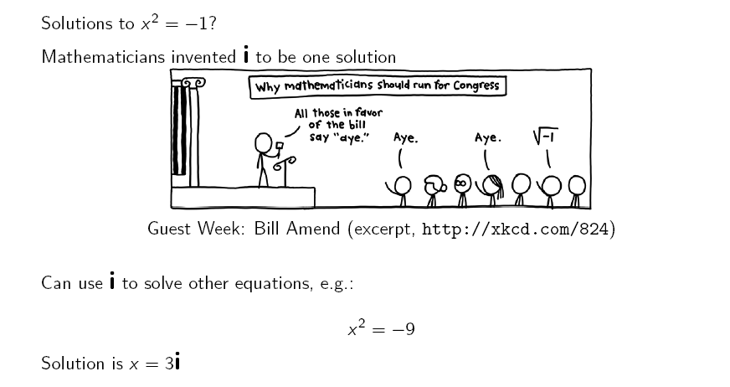
The Field: Introduction to complex numbers

Slide 11
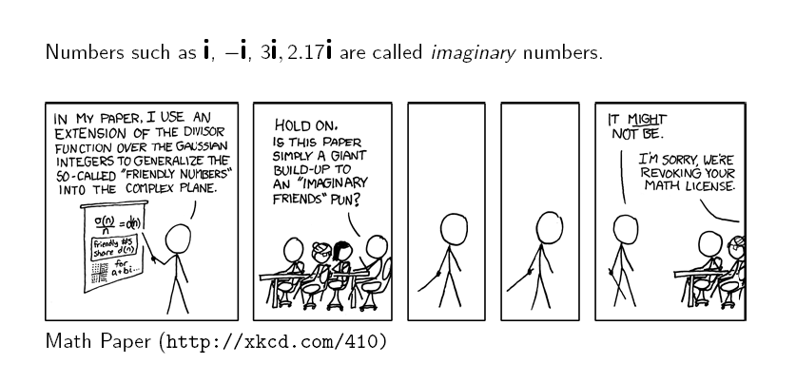
Introduction to complex numbers

Slide 12
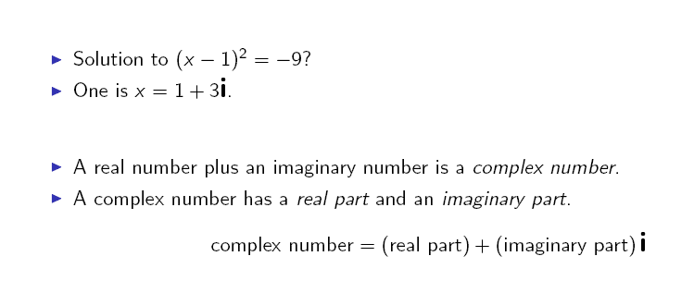
The Field: Introduction to complex numbers

Slide 13

The Field: Complex numbers in Python

Slide 14
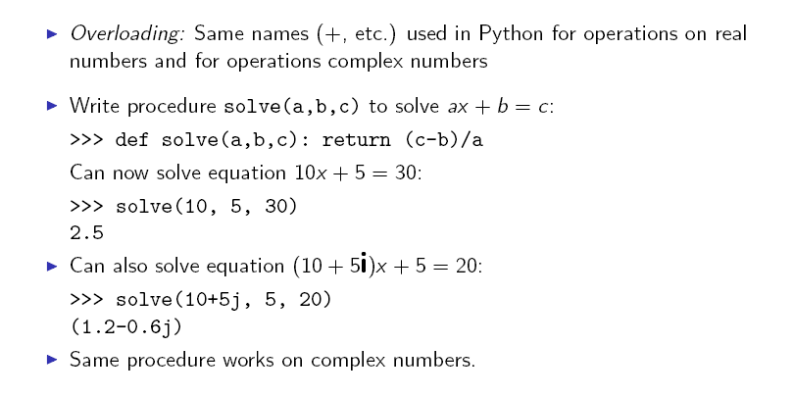
Abstracting over Fields

Slide 15
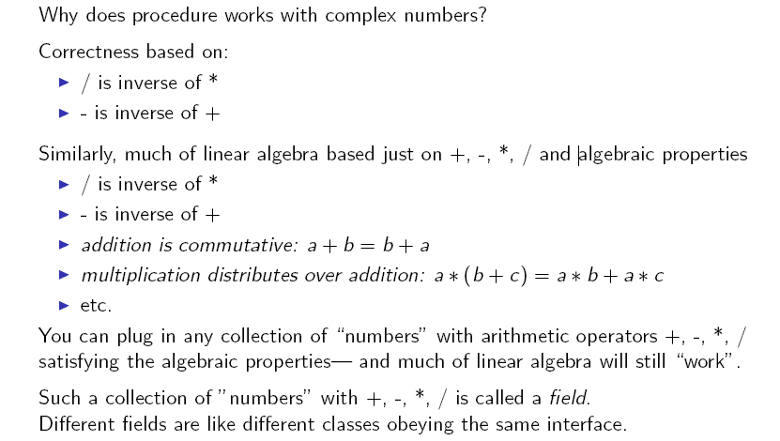
Abstracting over Fields

Slide 16
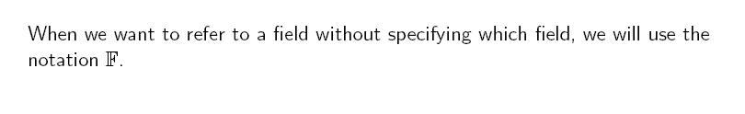
Field notation

Slide 17
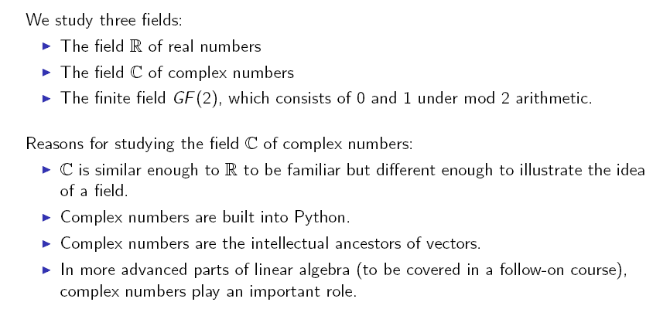
Abstracting over Fields

Slide 18
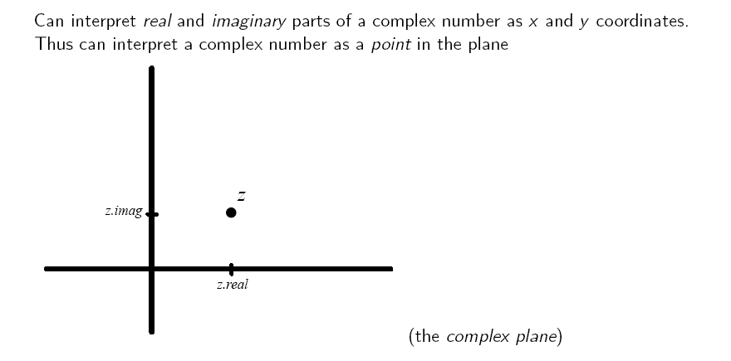
Complex numbers as points in the complex plane

Slide 19
Playing with C

Slide 20
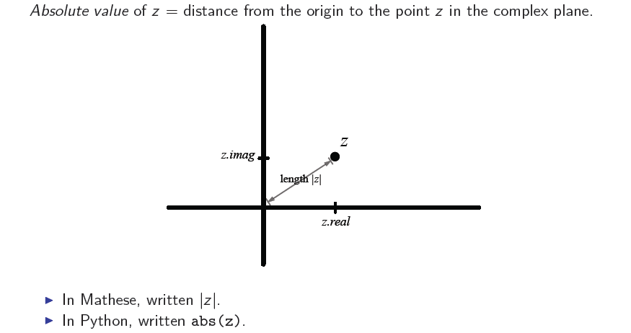
Playing with C: The absolute value of a complex number

Slide 21
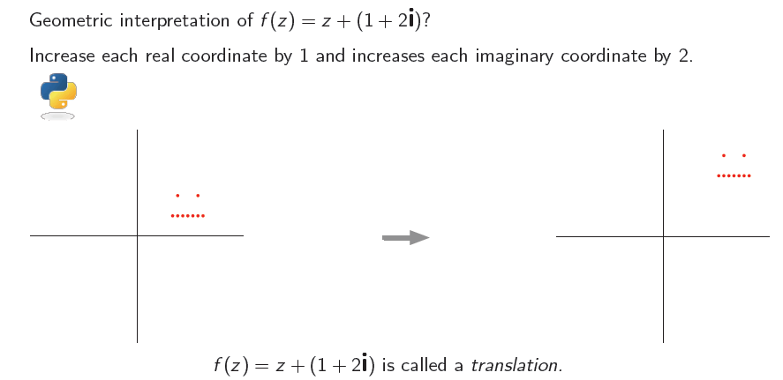
Playing with C: Adding complex numbers

Slide 22
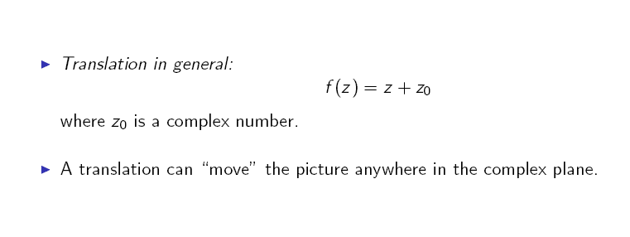
Playing with C: Adding complex numbers

Slide 23
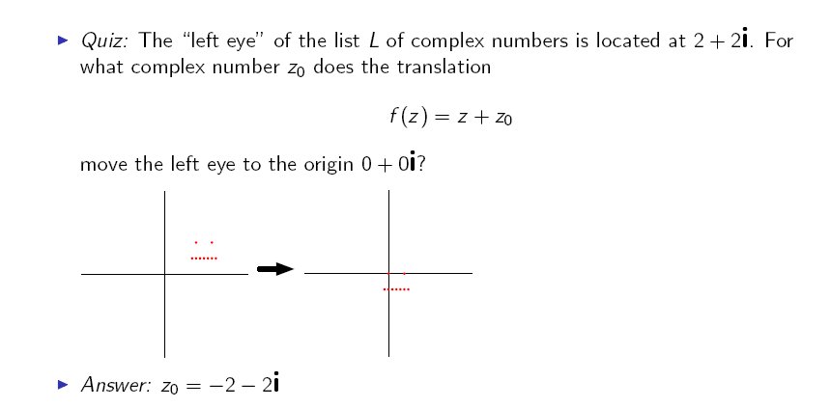
Playing with C: Adding complex numbers

Slide 24
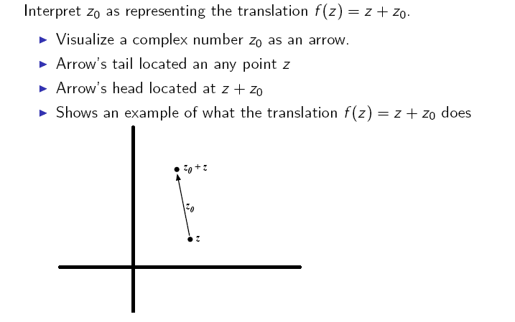
Playing with C: Adding complex numbers: Complex numbers as arrows

Slide 25
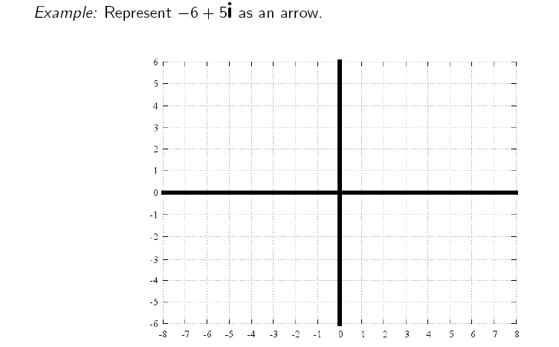
Playing with C: Adding complex numbers: Complex numbers as arrows

Slide 26
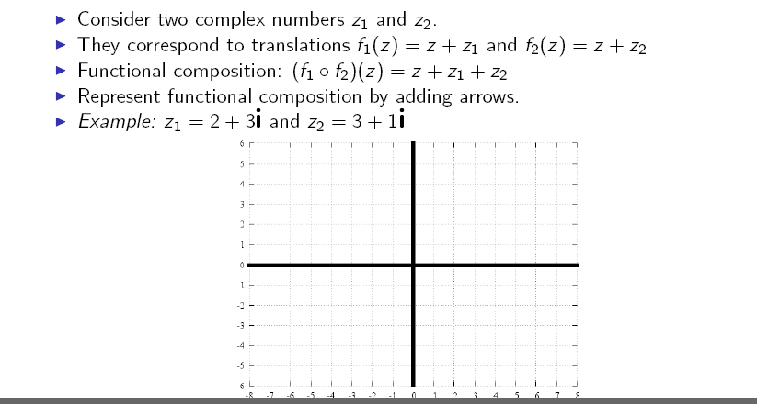
Playing with C: Adding complex numbers: Complex numbers as arrows

Slide 27
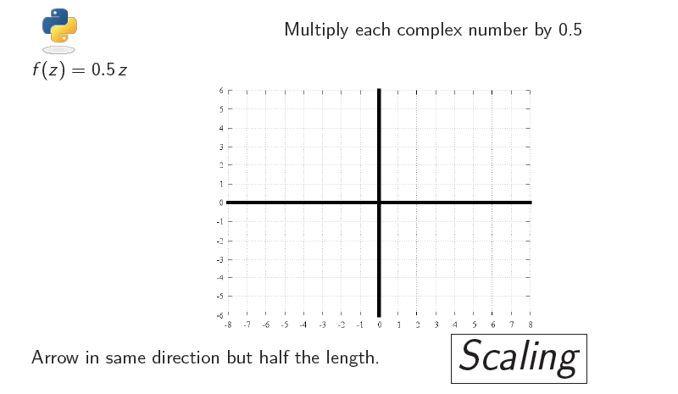
Playing with C: Multiplying complex numbers by a positive real number

Slide 28
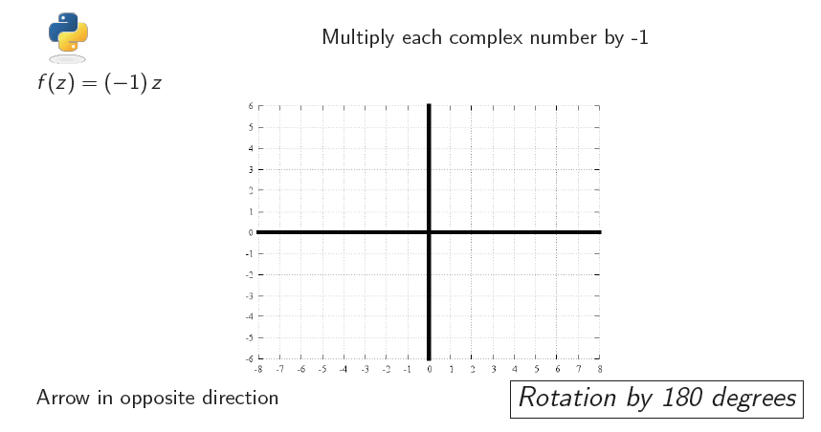
Playing with C: Multiplying complex numbers by a negative number

Slide 29
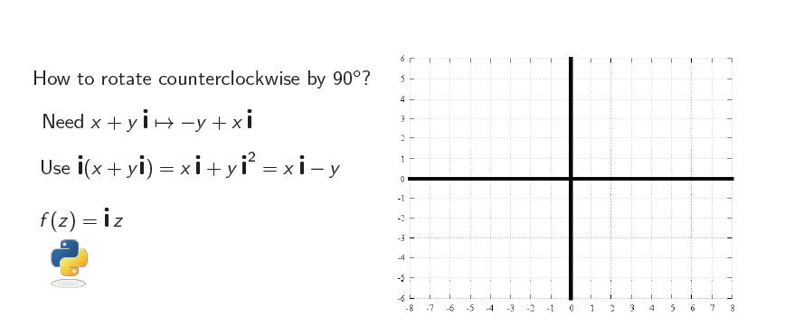
Playing with C: Multiplying by i: rotation by 90 degrees

Slide 30
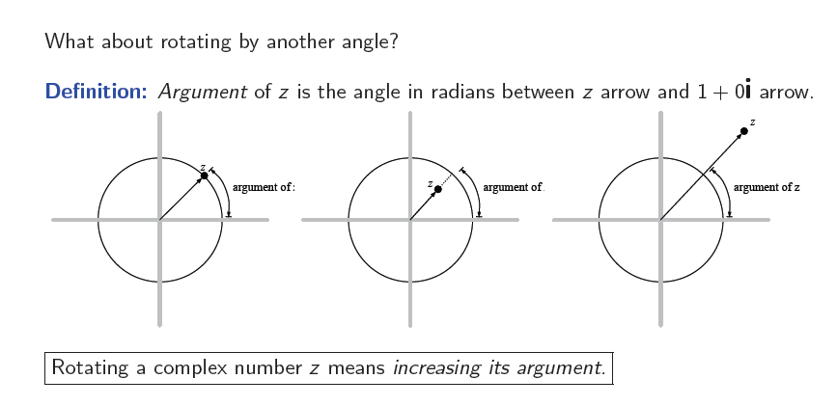
Playing with C: The unit circle in the complex plane: argument and angle

Slide 31
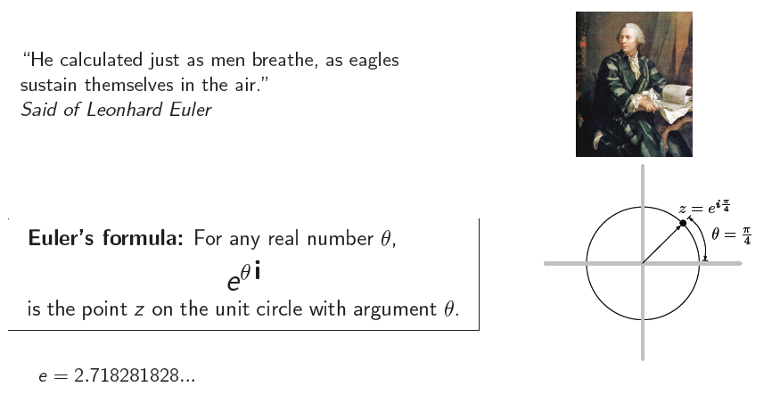
Playing with C: Euler's formula

Slide 32
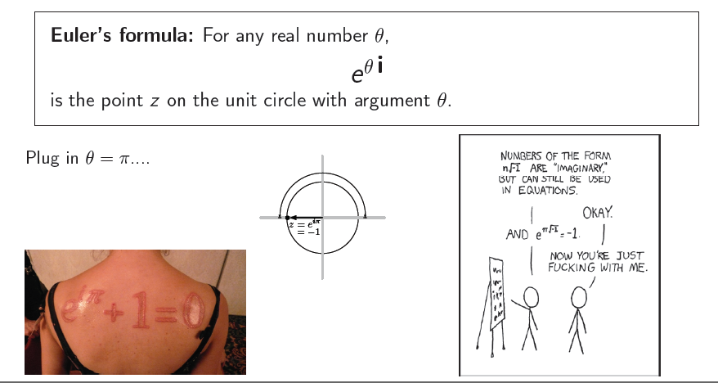
Playing with C: Euler's formula

Slide 33
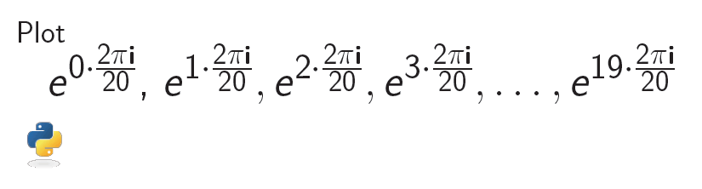
Playing with C: Euler's formula

Slide 34
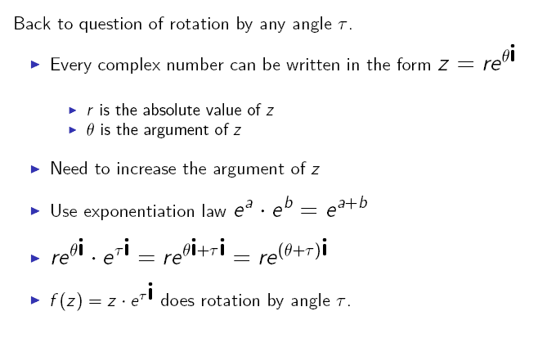
Playing with C: Rotation by radians

Slide 35
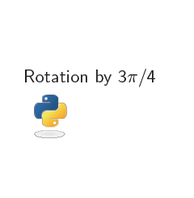
Playing with C: Rotation by radians

Slide 36
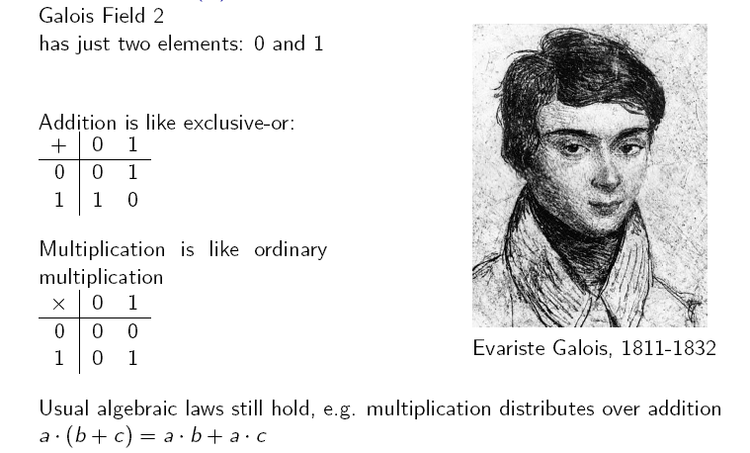
Playing with GF(2)

Slide 37
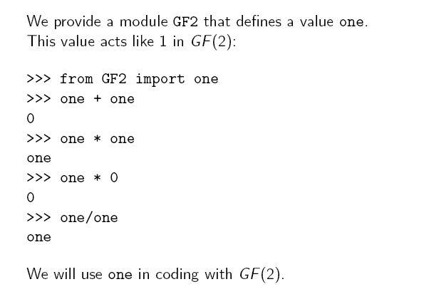
GF(2) in Python

Slide 38
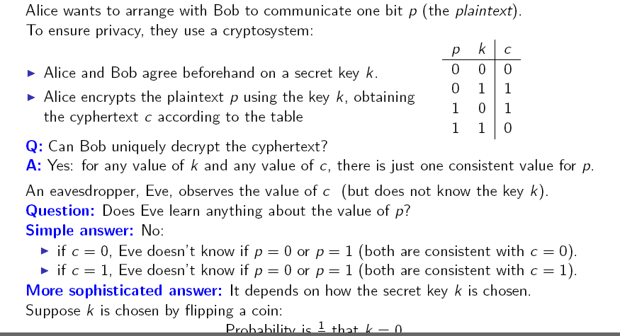
Playing with GF(2): Encryption

Slide 39
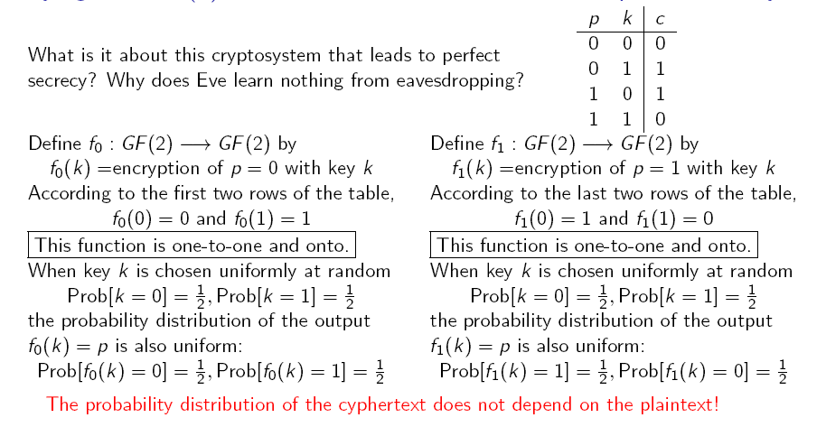
Playing with GF(2): One-to-one and onto function and perfect secrecy

Slide 40
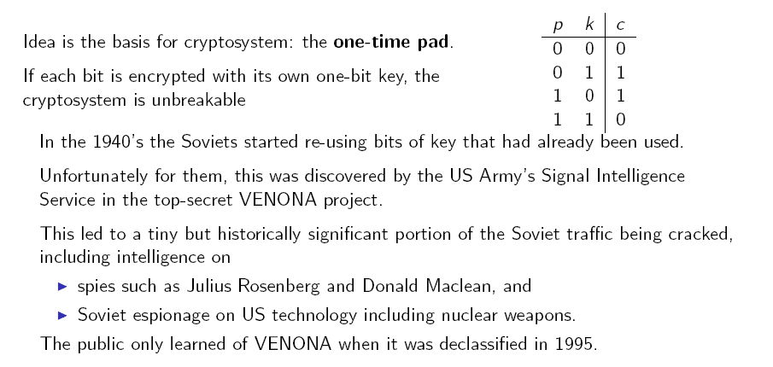
Perfect secrecy

Slide 41
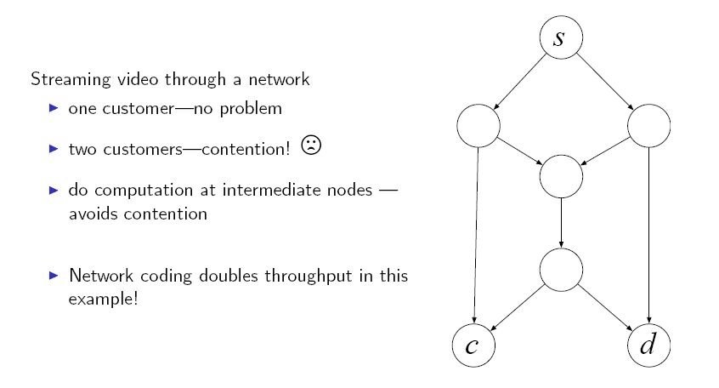
Playing with GF(2): Network coding

Slide 42
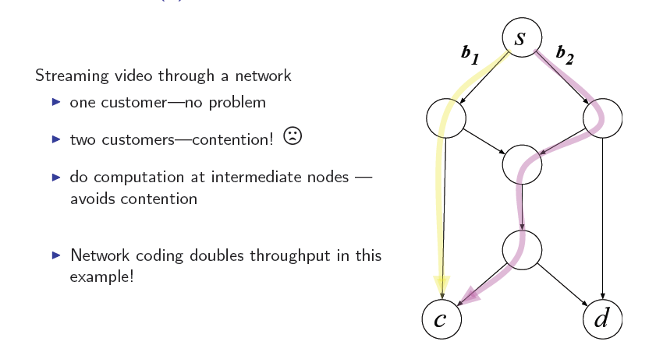
Playing with GF(2): Network coding

Slide 43
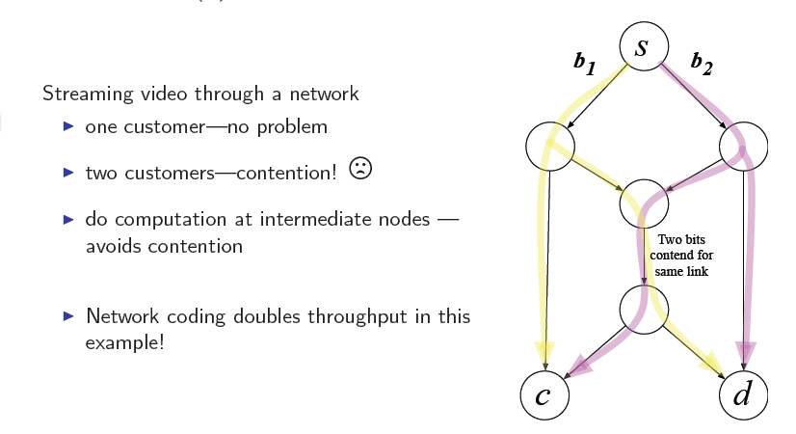
Playing with GF(2): Network coding

Slide 44
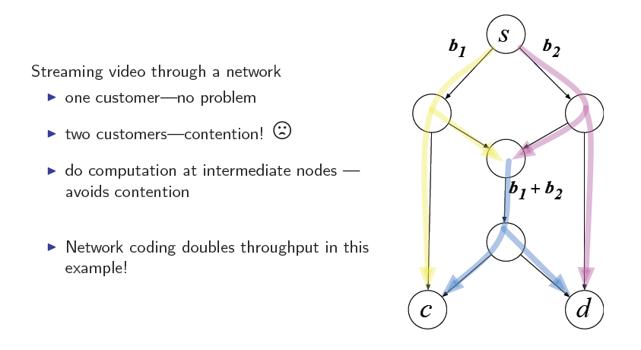
Playing with GF(2): Network coding

Slide 45

Q & A

